Slide 1
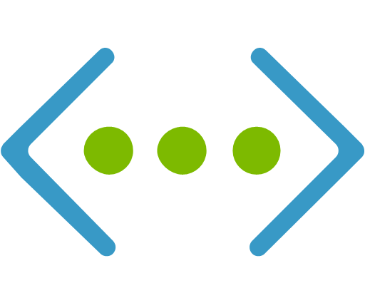

The Network
Network Engineer responsible for the creation of virtual network, virtual machines, and load balancing.
Established virtual network on 10.1.1.0/24
Created virtual machines within the same availability set
Virtual machines and load balancer enable different firewall rules to allow different functions
Load balanced the virtual machines to redirect web traffic in the event of server shutdown

